Slide 1

Logistics Optimization for Delivery Routes – FedEx
By - SRIVALLIKA

Slide 2
The goal is to come up with a SQL, based Logistics Analytics System for FedEx that can analyze shipment performance data across the global logistics network. With this system, it has aimed to:
Integrate ordering, routing, warehousing, agent, and shipment tracking data from relational databases.
Pinpoint the causes of delays, the bottlenecks, and the inefficiencies in the operations of both international and regional routes.
The outcome will be that performance evaluation will be made possible at the level of the route, warehouse, and delivery agent.
Offer data, backed insights that can be used to work on various aspects such as on, time delivery, route optimization, increasing warehouse throughput, and at the same time lowering operational costs.
The final analysis will be instrumental in making strategic decisions on how to best utilize hubs, optimize routes, and maintain service level reliability across FedEx's global operations.
PROJECT OBJECTIVE:

Slide 3
TASK 1 : Data Cleaning & Preparation
OBJECTIVE:
Check that the data is correct before analyzing performance. Get rid of inconsistencies that affect delivery and delay metrics.
Make a dataset that you can trust for logistics optimization
Cleaning Actions Performed
Getting rid of duplicate records
Handling of missing delay values
Standardizing dates
Finding an invalid delivery date
Checking for referential integrity

Slide 4


Identify and delete duplicate Order_ID or Shipment_ID records.
For Order_id :
SELECT Order_ID, COUNT(*) AS duplicate_countFROM orders GROUP BY Order_IDHAVING COUNT(*) > 1;
for shipment_id :
SELECT Shipment_ID, COUNT(*) AS duplicate_countFROM shipmentsGROUP BY Shipment_IDHAVING COUNT(*) > 1;
No duplicate records were detected
Replace null or missing Delay_Hours values in the Shipments Table with the average delay for that Route_ID.
select delay_hours from shipments;
UPDATE shipments shipJOIN ( SELECT Route_ID, AVG(Delay_Hours) AS avg_delay FROM shipments WHERE Delay_Hours IS NOT NULL GROUP BY Route_ID) routeON ship.Route_ID = route.Route_IDSET ship.Delay_Hours = route.avg_delayWHERE ship.Delay_Hours IS NULL;
All NULL values were successfully removed

Slide 5
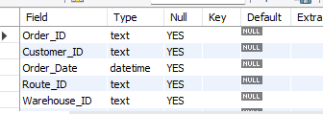
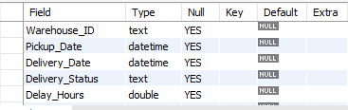
Convert all date columns (Order_Date, Pickup_Date, Delivery_Date) into YYYY-MM-DD HH:MM:SS format using SQL date functions.
ORDERS TABLE :
Select order_date from orders;
UPDATE ordersSET Order_Date = STR_TO_DATE(Order_Date, '%Y-%m-%d %H:%i:%s')WHERE Order_Date IS NOT NULL;
ALTER TABLE ordersMODIFY Order_Date DATETIME;
desc orders;
SHIPMENTS TABLE :
UPDATE shipments SET Pickup_Date = STR_TO_DATE(Pickup_Date, '%Y-%m-%d %H:%i:%s'), Delivery_Date = STR_TO_DATE(Delivery_Date, '%Y-%m-%d %H:%i:%s’) WHERE Pickup_Date IS NOT NULL OR Delivery_Date IS NOT NULL;
ALTER TABLE shipmentsMODIFY Pickup_Date datetime,modify Delivery_Date DATETIME;
desc shipments;

Slide 6
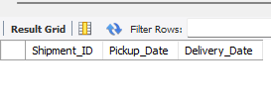
Ensure that no Delivery_Date occurs before Pickup_Date (flag such records)
SELECT Shipment_ID,Pickup_Date,Delivery_Date FROM shipmentsWHERE Delivery_Date < Pickup_Date;
Validate referential integrity between Orders, Routes, Warehouses, and Shipments.
- orders - route
SELECT o.Order_ID, o.Route_IDFROM orders oLEFT JOIN routes rON o.Route_ID = r.Route_IDWHERE r.Route_ID IS NULL;
-- orders – warehouse
SELECT o.Order_ID, o.Warehouse_IDFROM orders oLEFT JOIN warehouses wON o.Warehouse_ID = w.Warehouse_IDWHERE w.Warehouse_ID IS NULL;
-- orders-shipment
SELECT s.Shipment_ID, s.Order_IDFROM shipments sLEFT JOIN orders oON s.Order_ID = o.Order_IDWHERE o.Order_ID IS NULL;
-- shipment-route
SELECT s.Shipment_ID, s.Route_IDFROM shipments sLEFT JOIN routes rON s.Route_ID = r.Route_IDWHERE r.Route_ID IS NULL;
-- shipments - warehouse
SELECT s.Shipment_ID, s.Warehouse_IDFROM shipments sLEFT JOIN warehouses wON s.Warehouse_ID = w.Warehouse_IDWHERE w.Warehouse_ID IS NULL;

Slide 7

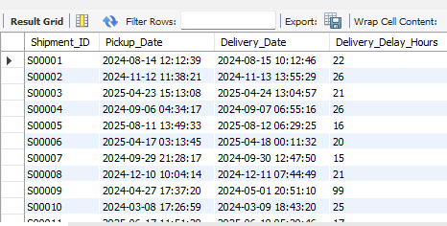
TASK 2: DELIVERY DELAY ANALYSIS
OBJECTIVE
Analyze delivery delays to identify inefficient routes, warehouses, and service types impacting delivery performance.
TASKS :
Calculate delivery delay (in hours) for each shipment using Delivery_Date – Pickup_Date.
SELECT
Shipment_ID,
    Pickup_Date,
    Delivery_Date,
    TIMESTAMPDIFF(HOUR, Pickup_Date, Delivery_Date) AS Delivery_Delay_Hours
FROM Shipments;
What was calculated:
The delivery delay for each shipment in hours using the time
difference between pickup and delivery.
What we got:
Each shipment now has a clear delay value, making it easy
to identify how long deliveries actually took.

Slide 8
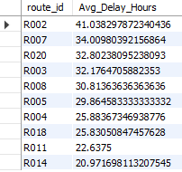
Top 10 delayed routes based on average delay hours.
SELECT route_id,
  AVG(Delay_Hours) AS Avg_Delay_Hours
  FROM Shipments
  GROUP BY Route_ID
  ORDER BY Avg_Delay_Hours DESC
  LIMIT 10;
What was calculated:
Average delay hours per route and ranked to find the top 10 most delayed routes.
What we got:
A list of routes that consistently experience the highest delays, highlighting where route optimization is most needed.

Slide 9
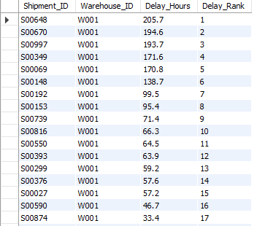
  Rank shipments by delay within each Warehouse_ID
  SELECT
  Shipment_ID,
  Warehouse_ID,
  Delay_Hours,
  RANK() OVER (
  PARTITION BY Warehouse_ID
  ORDER BY Delay_Hours DESC
  ) AS Delay_Rank
  FROM Shipments;
What was calculated:
Shipments were ranked by delay within each warehouse using a SQL window
function.
What we got:
This shows which shipments caused the highest delays inside each warehouse, helping identify internal bottlenecks.

Slide 10

  Identify the average delay per Delivery_Type (Express / Standard) to compare service-level efficiency.
SELECT
o.Delivery_Type,
AVG(
TIMESTAMPDIFF(HOUR, s.Pickup_Date, s.Delivery_Date)
) AS Avg_Delivery_Delay_Hours
FROM Shipments s
JOIN Orders o
ON s.Order_ID = o.Order_ID
GROUP BY o.Delivery_Type;
What was calculated:
Average delivery delay for Express and Standard services.
What we got:
A clear comparison of service-level efficiency, showing which delivery type performs faster and which needs improvement.

Slide 11
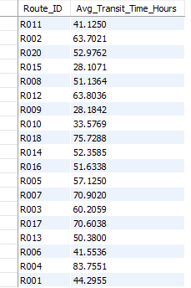
TASK 3: ROUTE OPTIMIZATION INSIGHTS
OBJECTIVE
Evaluate route performance using time, delay, and distance metrics
Identify inefficient and delay-prone routes
Highlight routes that require optimization or operational review
TASKS :
Average transit time (in hours) across all shipments.
SELECT
Route_ID,
AVG(TIMESTAMPDIFF(HOUR, Pickup_Date, Delivery_Date))
AS Avg_Transit_Time_Hours
FROM Shipments
GROUP BY Route_ID;
What was calculated:
The average transit time (in hours) taken by shipments on each route.
What we got:
A clear view of how long shipments usually take on every route,
helping compare fast and slow routes.

Slide 12
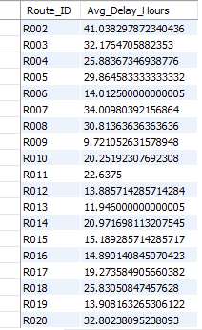
Average delay (in hours) per route.
SELECT
Route_ID,
AVG(Delay_Hours) AS Avg_Delay_Hours
FROM Shipments
GROUP BY Route_ID order by Route_id;
What was calculated:
The average delay (in hours) experienced on each route.
What we got:
Routes with consistently higher delays were identified, showing which routes are
operationally weak.

Slide 13
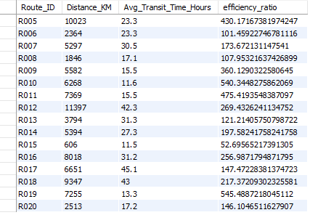
Distance-to-time efficiency ratio = Distance_KM / Avg_Transit_Time_Hours.
SELECT
Route_ID,
Distance_KM,
Avg_Transit_Time_Hours,
Distance_KM / Avg_Transit_Time_Hours AS efficiency_ratio
FROM Routes;
What was calculated:
An efficiency ratio defined as distance traveled per
hour (Distance_KM / Avg_Transit_Time_Hours).
What we got:
This metric shows how efficiently each route covers
distance over time — higher values mean better route
performance.
.

Slide 14

Identify 3 routes with the worst efficiency ratio (lowest distance-to-time).
SELECT
Route_ID,
Distance_KM,
Avg_Transit_Time_Hours,
Distance_KM / Avg_Transit_Time_Hours AS Distance_Time_Efficiency
FROM Routes
ORDER BY Distance_Time_Efficiency ASC
LIMIT 3;
What was calculated:
Routes were ranked by efficiency ratio in ascending order.
What we got:
The bottom 3 routes with the lowest efficiency were identified, indicating poor distance coverage relative to time taken.

Slide 15
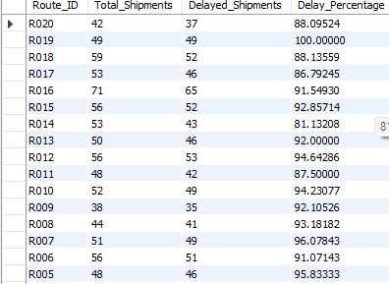
Find routes with >20% of shipments delayed beyond expected transit time.
WITH Route_Delay AS (
SELECT
s.Route_ID,
COUNT(*) AS Total_Shipments,
SUM(
CASE
WHEN TIMESTAMPDIFF(HOUR, s.Pickup_Date, s.Delivery_Date)
> r.Avg_Transit_Time_Hours
THEN 1 ELSE 0
END
) AS Delayed_Shipments,
(SUM(
CASE
WHEN TIMESTAMPDIFF(HOUR, s.Pickup_Date, s.Delivery_Date)
> r.Avg_Transit_Time_Hours
THEN 1 ELSE 0
END
) * 100.0 / COUNT(*)) AS Delay_Percentage
FROM Shipments s
JOIN Routes r ON s.Route_ID = r.Route_ID
GROUP BY s.Route_ID)
SELECT *
FROM Route_Delay
WHERE Delay_Percentage > 20
ORDER BY Route_ID DESC;
What was calculated:
The percentage of delayed shipments for each route.
What we got:
Routes where more than 20% of shipments were delayed were flagged, highlighting routes that require immediate operational review.

Slide 16
Recommend potential routes or hub pairs for optimization.
Recommendation 1: Adjust Distances Between Destinations with High Rates of Delay
If more than 20% of your shipments are arriving later than expected due to high delays, this suggests that the warehouses serving both destinations may have reached maximum capacity or are using inefficiently connected hub/warehouses. To reduce the delays associated with these types of routes, you can transfer shipment volumes from congested or lack of warehouse spaces to other nearby warehouses (that currently have unutilized warehouse capacity).
Recommendation 2: Improve Delivery Performance of High Volume/High Delay Route
If two routes both have a high volume of shipments as well as a high rate of delays, analysis should be conducted to determine if you can expand the operation by either adding more delivery agents, increasing the processing abilities of the warehouse, or adding additional intermediate hubs to eliminate congestion (i.e., bottlenecks).
Recommendation 3: Align Expected Transit Times with Actual Transit Time. When routes consistently take longer than expected, historical shipment data needs to be used to recalculate Average Planned Transit Times so that customers have a realistic SLA and experience higher levels of satisfaction.
Recommendation 4: Optimize Low Efficiency Routes. These routes take the longest amount of time for the shortest distance traveled and should be optimized first. A low efficiency route is an indication that the speed at which a shipment is moving through the network is slower than it could be relative to the distance it has traveled. If congestion, poor scheduling, or poor hub selection is the cause of the low efficiency route, rerouting shipments through a different hub and changing dispatch scheduling can lead to a significant improvement in speed when running transit
CONCLUSION : By optimizing routes with low efficiency ratios and a high percentage of delays, FedEx can maximize its Hub Utilisation, minimize transit delays, and improve overall service level performance.

Slide 17

TASK 4: WAREHOUSE PERFORMANCE
Objective
Evaluate warehouse-level delivery performance
Identify warehouses contributing the most to shipment delays
Compare warehouse performance against global delay benchmarks
TASKS:
Find the top 3 warehouses with the highest average delay in shipments dispatched.
SELECT
w.Warehouse_ID,
  w.City,
  w.Country,
  AVG(s.Delay_Hours) AS Avg_Delay
  FROM Shipments s
  JOIN Warehouses w
  ON s.Warehouse_ID = w.Warehouse_ID
  GROUP BY w.Warehouse_ID, w.City, w.Country
  ORDER BY Avg_Delay DESC
  LIMIT 3;
What was calculated:
The average delay in shipments dispatched from each warehouse.
What we got:
The top 3 warehouses with the highest average delays were identified, indicating locations where processing or dispatch efficiency is poor.

Slide 18
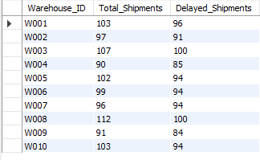
Calculate total shipments vs delayed shipments for each warehouse.
  SELECT
  Warehouse_ID,
  COUNT(*) AS Total_Shipments,
  SUM(Delay_Hours > 0) AS Delayed_Shipments
  FROM Shipments
  GROUP BY Warehouse_ID
  ORDER BY warehouse_id ASC;
What was calculated:
Total number of shipments and the number of delayed shipments for each warehouse.
What we got:
This shows how much delay each warehouse contributes, helping distinguish between high-volume issues and true inefficiency.

Slide 19
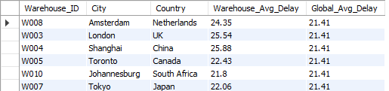
Use CTEs to identify warehouses where average delay exceeds the global average delay.
  WITH Global_Avg_Delay AS (
  SELECT
  AVG(Delay_Hours) AS Global_Avg
  FROM Shipments
  ),
  Warehouse_Avg_Delay AS (
  SELECT
  Warehouse_ID,
  AVG(Delay_Hours) AS Warehouse_Avg
  FROM Shipments
  GROUP BY Warehouse_ID
  )
  SELECT
  w.Warehouse_ID,
  w.City,
  w.Country,
  ROUND(wad.Warehouse_Avg, 2) AS Warehouse_Avg_Delay,
  ROUND(gad.Global_Avg, 2) AS Global_Avg_Delay
  FROM Warehouse_Avg_Delay wad
  JOIN Warehouses w
  ON wad.Warehouse_ID = w.Warehouse_ID
  CROSS JOIN Global_Avg_Delay gad
  WHERE wad.Warehouse_Avg > gad.Global_Avg;
What was calculated:
Warehouses whose average delay is higher than the global average delay across all shipments.
What we got:
Underperforming warehouses were flagged relative to the entire network, allowing focused corrective action.

Slide 20
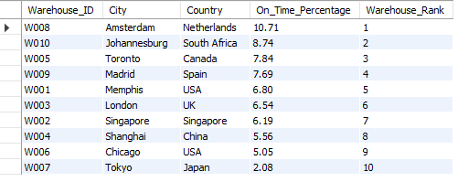
Rank all warehouses based on on-time delivery percentage.
  SELECT
  w.Warehouse_ID,
  w.City,
  w.Country,
  ROUND(
  SUM(s.Delay_Hours <= 0) * 100.0 / COUNT(*),
  2
  ) AS On_Time_Percentage,
  RANK() OVER (
  ORDER BY SUM(s.Delay_Hours <= 0) * 1.0 / COUNT(*) DESC
  ) AS Warehouse_Rank
  FROM Shipments s
  JOIN Warehouses w
  ON s.Warehouse_ID = w.Warehouse_ID
  GROUP BY w.Warehouse_ID, w.City, w.Country;
What was calculated:
On-time delivery percentage for each warehouse and ranked accordingly.
What we got:
A clear ranking of warehouses from best to worst based on reliability, highlighting both top performers and problem locations.

Slide 21
TASK 5: DELIVERY AGENT PERFORMANCE
Objective
Evaluate delivery agent performance across routes
Identify agents with low on-time delivery reliability
Compare top and bottom performing agents to support training and workload decisions

Slide 22
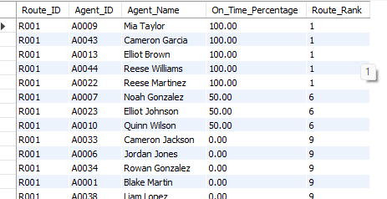
Rank delivery agents (per route) by on-time delivery percentage.
SELECT
s.Route_ID,
a.Agent_ID,
a.Agent_Name,
ROUND(
100 * AVG(
CASE
WHEN TIMESTAMPDIFF(HOUR, s.Pickup_Date, s.Delivery_Date)
<= r.Avg_Transit_Time_Hours
THEN 1 ELSE 0
END ), 2
) AS On_Time_Percentage,
RANK() OVER (
PARTITION BY s.Route_ID
ORDER BY
100 * AVG(
CASE
WHEN TIMESTAMPDIFF(HOUR, s.Pickup_Date, s.Delivery_Date)
<= r.Avg_Transit_Time_Hours
THEN 1 ELSE 0
END
) DESC
) AS Route_Rank
FROM Shipments s
JOIN Delivery_Agents a ON s.Agent_ID = a.Agent_ID
JOIN Routes r ON s.Route_ID = r.Route_ID
GROUP BY s.Route_ID, a.Agent_ID, a.Agent_Name;
What was calculated:
The on-time delivery percentage for each agent on every route and ranked them within the route.
What we got:
This shows the best and worst performing agents for each route, making agent-level performance differences clearly visible.

Slide 23
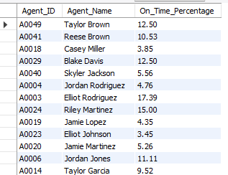
Find agents whose on-time % is below 85%.
SELECT
a.Agent_ID,
a.Agent_Name,
ROUND(
100 * AVG(
CASE
WHEN TIMESTAMPDIFF(HOUR, s.Pickup_Date, s.Delivery_Date)
<= r.Avg_Transit_Time_Hours
THEN 1 ELSE 0
END
),
2
) AS On_Time_Percentage
FROM Shipments s
JOIN Delivery_Agents a
ON s.Agent_ID = a.Agent_ID
JOIN Routes r
ON s.Route_ID = r.Route_ID
GROUP BY a.Agent_ID, a.Agent_Name
HAVING On_Time_Percentage < 85;
What was calculated:
Average on-time delivery percentage per agent across all shipments.
What we got:
Agents performing below the 85% threshold were identified, highlighting those who require attention or corrective action.

Slide 24

Compare the average rating and experience (in years) of the top 5 vs bottom 5 agents using subqueries.
SELECT 'Top 5 Agents', AVG(Rating), AVG(Experience_Years)
FROM (
SELECT * FROM Agent_Performance
ORDER BY On_Time_Percentage DESC
LIMIT 5
) t
UNION ALL
SELECT 'Bottom 5 Agents', AVG(Rating), AVG(Experience_Years)
FROM (
SELECT * FROM Agent_Performance
ORDER BY On_Time_Percentage ASC
LIMIT 5
) b;
What was calculated:
Average rating and experience of the top 5 and bottom 5 agents based on on-time delivery percentage.
What we got:
Top-performing agents generally show higher ratings and experience, while low performers indicate gaps in skills or workload balance.

Slide 25
Suggest training or workload balancing strategies for low-performing agents based on insights.
Key Findings from the Data
Agents that rank the lowest have a significant number of delayed deliveries. Low on-time deliveries indicate the presence of a systemic problem rather than occasional delays.
Agents that are in the bottom 5 group also have lower average scores and have less actual experience, which indicates that an agent's experience and skill affect their performance.
Routes associated with agents produce significant variations in performance. This means that delays on a route are often attributed to a significant number of variables including route difficulty and/or workload, as opposed to simply the individual agent.
Common Concerns Identified
Agents with insufficient experience managing complex routes
Ineffective route planning and time estimating
An overburdened scheduling of delivery appointments
The absence of a method for correlating the performance of agents to the assignment of delivery routes
No mechanism for intervention in cases of continued underperformance, up to and including the agent's ultimate termination.
Recommendations
Specific Form of Training: Train only those agents with an average on-time delivery record below 85% on procedures in areas of familiarity with assigned routes, time management and the handling of delays.

Slide 26
Workload Assignment: Equalize delivery workload and avoid assigning complex routes or routes that require a significant time commitment to lower-performing agents.
Mentorship Program: Develop a mentoring program that will connect lower-performing agents to higher-performing agents who regularly travel the same routes, enabling them to acquire actionable knowledge
Route Assignment to Agents: Match the agent and the route to be served and counsel new agents regarding the assignment of less difficult routes until such time as they have accumulated sufficient experience to qualify to serve more difficult routes.
Monitoring Performance: Monitor agent performance metrics on a regular basis and intervene when an agent's performance remains below 85% over three consecutive months..

Slide 27
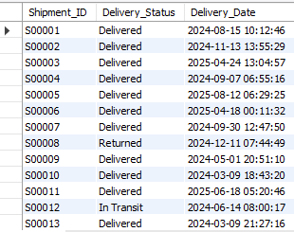
Task 6: Shipment Tracking Analytics
OBJECTIVE
Track the latest shipment status across the delivery lifecycle
Identify routes with unresolved or returned shipments
Detect severe delays to highlight operational bottlenecks
TASKS:
For each shipment, display the latest status (Delivered, In Transit, or Returned) along with the latest Delivery_Date.
SELECT
s.Shipment_ID,
s.Status,
s.Delivery_Date
FROM Shipments s
JOIN (
SELECT
Shipment_ID,
MAX(Delivery_Date) AS Latest_Delivery_Date
FROM Shipments
GROUP BY Shipment_ID
) latest
ON s.Shipment_ID = latest.Shipment_ID
AND s.Delivery_Date = latest.Latest_Delivery_Date;
What was calculated:
The most recent delivery date for every shipment along with its latest status.
What we got:
This shows the current state of each shipment (Delivered, In Transit, or Returned), enabling real-time tracking and monitoring.

Slide 28

Identify routes where the majority of shipments are still “In Transit” or “Returned”.
SELECT
Route_ID,
COUNT(*) AS Total_Shipments,
SUM(
CASE
WHEN Delivery_Status IN ('In Transit', 'Returned') THEN 1
ELSE 0
END
) AS Problem_Shipments
FROM Shipments
GROUP BY Route_ID
HAVING
SUM(
CASE
WHEN Delivery_Status IN ('In Transit', 'Returned') THEN 1
ELSE 0
END
) > COUNT(*) / 2;
What was calculated:
The number of shipments per route that are still In Transit or Returned and compared against total shipments.
What we got:
Routes where more than half the shipments are problematic were identified, highlighting routes with serious delivery issues.

Slide 29
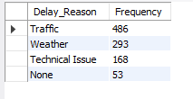
Find the most frequent delay reasons (if available in delay-related columns or flags).
SELECT
Delay_Reason,
COUNT(*) AS Frequency
FROM Shipments
WHERE Delay_Reason IS NOT NULL
GROUP BY Delay_Reason
ORDER BY Frequency DESC;
What was calculated:
The frequency of each delay reason across all shipments.
What we got:
The most common causes of delays were identified, helping prioritize which operational issues need immediate attention.

Slide 30
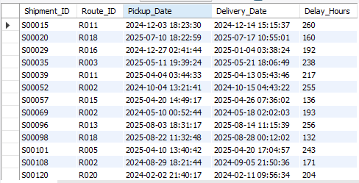
Identify orders with exceptionally high delay (>120 hours) to investigate potential bottlenecks.
SELECT
Shipment_ID,
Route_ID,
Pickup_Date,
Delivery_Date,
TIMESTAMPDIFF(HOUR, Pickup_Date, Delivery_Date) AS Delay_Hours
FROM Shipments
WHERE TIMESTAMPDIFF(HOUR, Pickup_Date, Delivery_Date) > 120;
What was calculated:
Total delivery delay in hours and filtered for
shipments delayed more than 120 hours.
What we got:
Severely delayed shipments were flagged,
indicating potential bottlenecks, escalation cases, or operational failures.

Slide 31
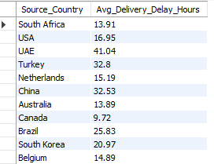
Task 7: Advanced KPI Reporting
Objective
Summarize key logistics performance indicators across the network
Measure delivery reliability, delay patterns, and warehouse capacity usage
Provide high-level KPIs to support strategic decision-making.
TASKS:
Average Delivery Delay per Source_Country.
SELECT
r.Source_Country,
ROUND(AVG(s.Delay_Hours), 2) AS Avg_Delivery_Delay_Hours
FROM Shipments s
JOIN Routes r
ON s.Route_ID = r.Route_ID
GROUP BY r.Source_Country;
What was calculated:
The average delivery delay (in hours) for shipments originating from each source country.
What we got:
Countries with higher average delays were identified, helping compare cross-border performance and regional efficiency.

Slide 32

On-Time Delivery % = (Total On-Time Deliveries / Total Deliveries) * 100.
SELECT
ROUND(
100 * AVG(
CASE
WHEN TIMESTAMPDIFF(HOUR, s.Pickup_Date, s.Delivery_Date)
<= r.Avg_Transit_Time_Hours
THEN 1
ELSE 0
END
),
2
) AS On_Time_Delivery_Percentage
FROM Shipments s
JOIN Routes r
ON s.Route_ID = r.Route_ID;
What was calculated:
The percentage of shipments delivered on or before the expected transit time.
What we got:
A single KPI showing overall delivery reliability across the network.

Slide 33
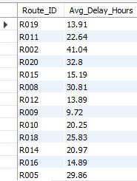
Average Delay (in hours) per Route_ID.
SELECT
Route_ID,
ROUND(
AVG(
CASE
WHEN Delay_Hours > 0
THEN Delay_Hours
ELSE 0
END
),
2
) AS Avg_Delay_Hours
FROM Shipments
GROUP BY Route_ID;
What was calculated:
The average delay (in hours) experienced on each route.
What we got:
Routes with consistently higher delays were highlighted, supporting targeted route-level improvements.

Slide 34
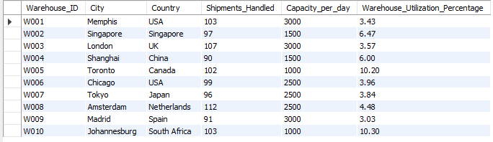
Warehouse Utilization % = (Shipments_Handled / Capacity_per_day) * 100.
SELECT
w.Warehouse_ID,
w.City,
w.Country,
COUNT(s.Shipment_ID) AS Shipments_Handled,
w.Capacity_per_day,
ROUND(
100 * COUNT(s.Shipment_ID) /
CASE
WHEN w.Capacity_per_day > 0
THEN w.Capacity_per_day
ELSE 1
END,
2
) AS Warehouse_Utilization_Percentage
FROM Warehouses w
LEFT JOIN Shipments s
ON w.Warehouse_ID = s.Warehouse_ID
GROUP BY
w.Warehouse_ID,
w.City,
w.Country,
w.Capacity_per_day;
What was calculated:
Warehouse utilization percentage based on actual shipments handled versus capacity.
What we got:
Warehouses that are over-utilized or under-utilized were identified, enabling better capacity planning and load balancing.

Slide 35
TASK 9 : Video Submission
Logistics Optimization for Delivery Routes – FedEx

